Slide 1
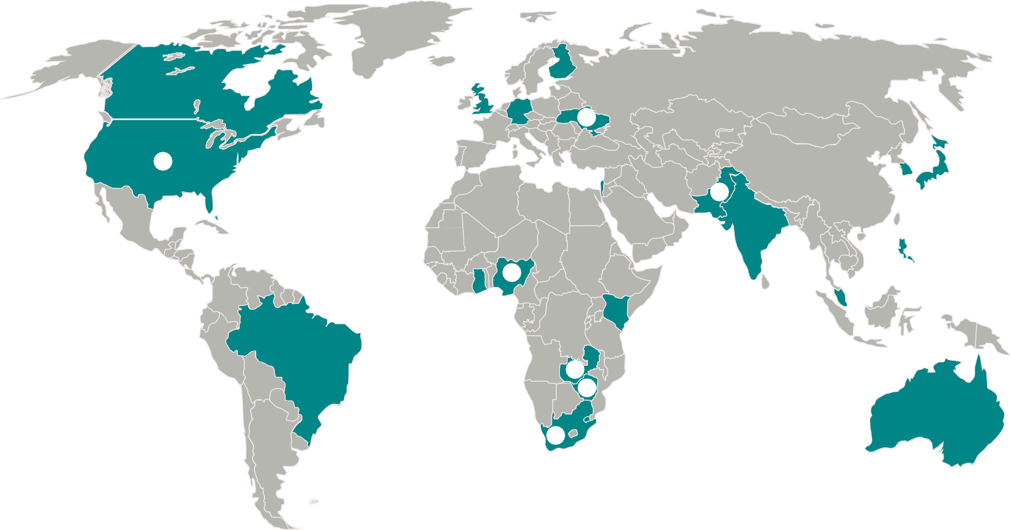

FAITH COMMUNIT Y NURSING IS ALIVE AROUND THE WORLD
canada
ukraine
interchurch health ministries canada is driven by the vision
❻
the association for christian
nurses and volunteers-welfare
of “a parish nurse in every
19
created to train and support faith community nurses, pastors, and laypersons to promote holistic health.
congregation.”
❹
5
usa
❼
pakistan
lutheran chaplain granger westberg identifies key role of nurses in churches igniting the contemporary parish nurse movement in 1984. his work is carried forward by the church health center and the health ministries association.
26
24
more than 100 faith community
SLOVAKIA
nurses and faculty trained in classroom and online courses offered through a
ftermany
collaborative partnership with
25
a 170+ year history of parish nursing
17
a us nurse educator.
10
begun in 1836 with lutheran pastor theodor fliedner at kaiserswerth by formally training religious women as deaconess nurses to work in hospitals, parishes, and schools.
16
22
FCNs are active in:
2
❾
Australia
Bahamas
Brazil
Canada
England
Finland
Germany
Ghana 9.
18
❽
15
13
COLOMBIA
20
11
India
Japan
Kenya
Madagascar 13.
14.
15.
16.
17.
18.
19.
20.
21.
22.
23.
24.
25. USA 26.
27.
28.
❸
australia
collaborative partnerships
27
formed to promote creative
Malaysia
faith community nurse
New Zealand
outreach throughout the
Nigeria Pakistan
28
12
eastern states.
Palestine Philippines Scotland Singapore
❶
21
23
South Africa
swaziland
South Korea Swaziland
parish nurses reach out to communities in response to unmet needs of persons struggling with hiv/aids
14
Ukraine
through an outreach
Wales Zambia
program titled “a new robe.”
Zimbabwe
THE WORLD FORUM FOR FAITH COMMUNITY NURSINft MINISTRIES
F AITH CFO MCMUN INTY NURSING
The World Forum for Faith Community Nursing Ministries is an international, multifaith, multicultural, collaborative group focused on global action through faith community nursing. The World Forum began at the 2004 Westberg Symposium following a pre-conference session highlighting international faith community nursing. Twenty-two
^{F}fr^{C}ien^{N}d
Faith Communit� Nursing
Friend
visionary members gathered to create an infrastructure of resource sharing and collaboration.
This map highlights a few of the many FCN initiatives taking place around the world.

